Slide 1
Charging Stations Market Leader in Oregon

Slide 2
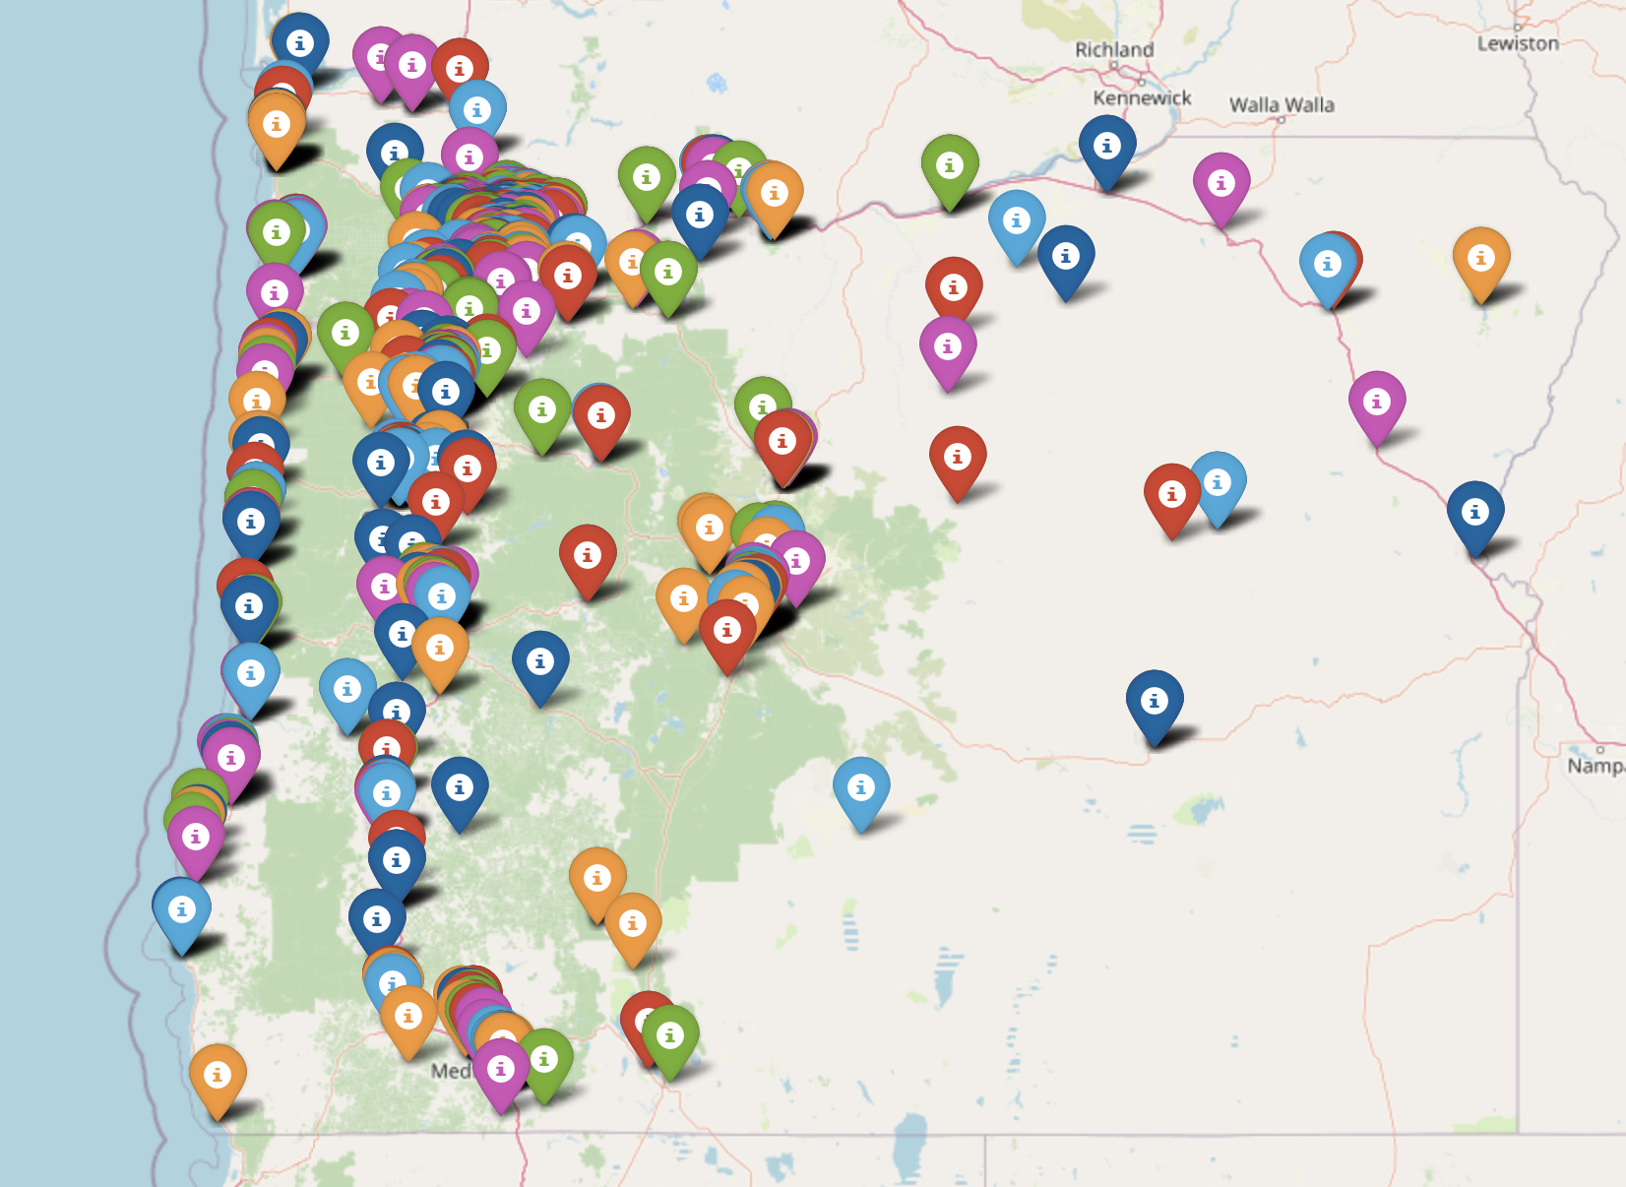
Representation of Different charging stations in Oregon (906 total)

Slide 3
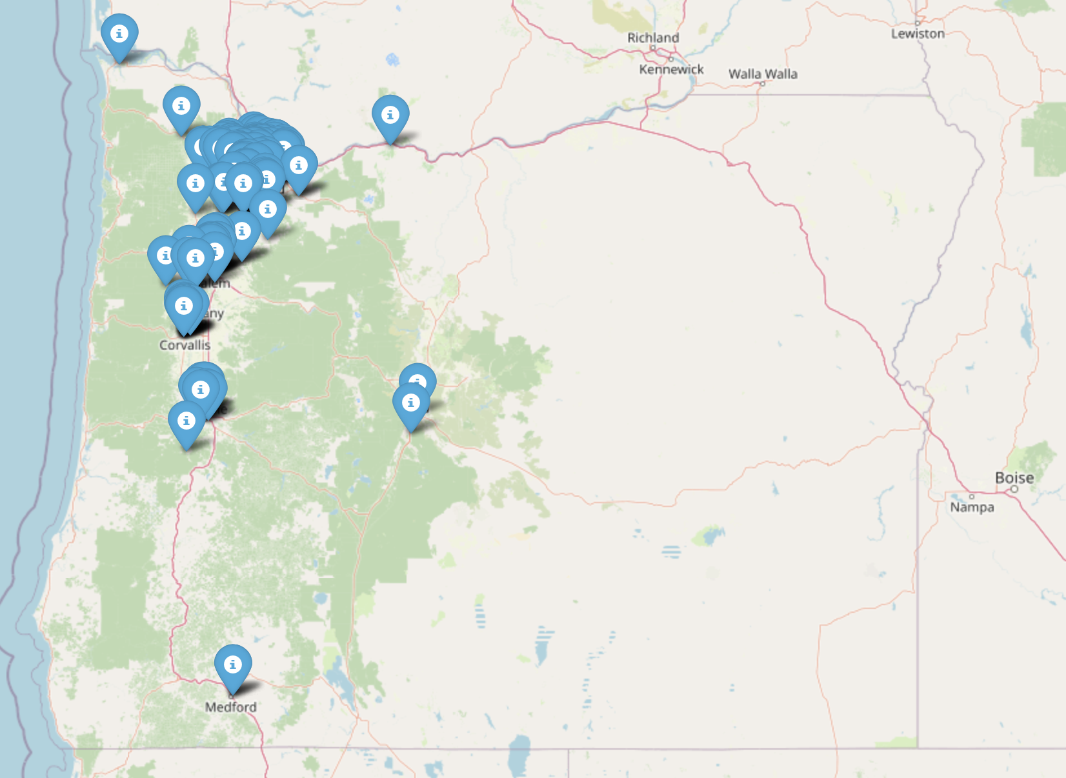
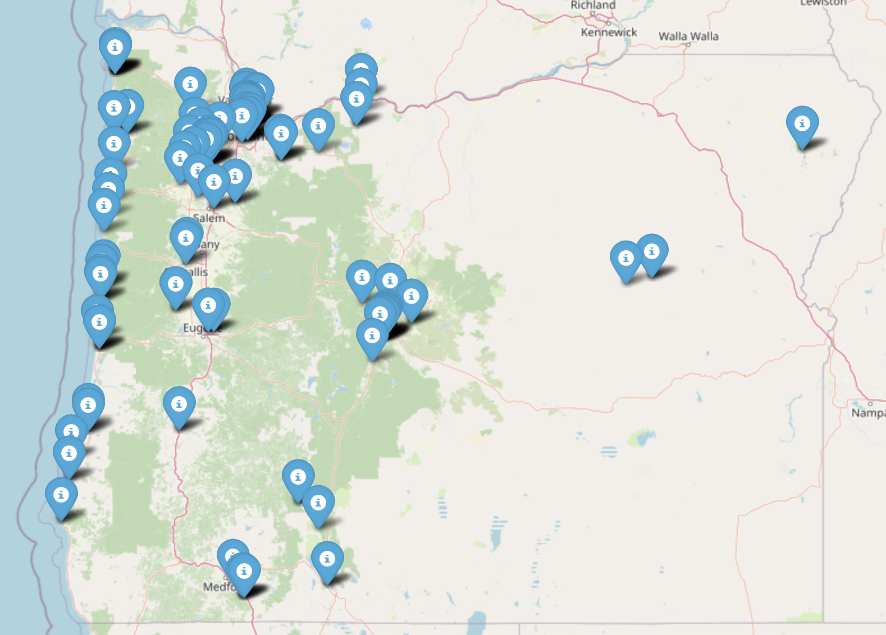
Two market leaders in charging station infrastructure
“Blink Charging network vs Tesla Destination Network”
155 Total
149 Total

Slide 4
Insights
The state of Oregon benefits greatly from its extensive network of charging stations. However, different brands have taken varying approaches to address the topology and logistical constraints associated with installing these stations.
Among the various brands, the Blink network stands out with the highest number of charging stations in Oregon. However, as depicted in earlier slides, Blink primarily focuses its presence in major metropolitan areas such as Portland, Salem, Albany, and Corvallis.
On the other hand, the Tesla Destination network demonstrates a more extensive coverage across the eastern coast of Oregon, as well as the major population centers including Portland, Salem, Albany, and Corvallis.
Interestingly, this analysis has revealed valuable insights about a charging network that has the fewest stations among the major market leaders but boasts the most extensive coverage area in Oregon. Specifically, the network has made significant inroads into South-Eastern Oregon, particularly in the town of Burns.
Overall, these findings shed light on the diverse strategies employed by different brands to address charging infrastructure in Oregon, showcasing both their strengths and areas of focus.

Slide 5
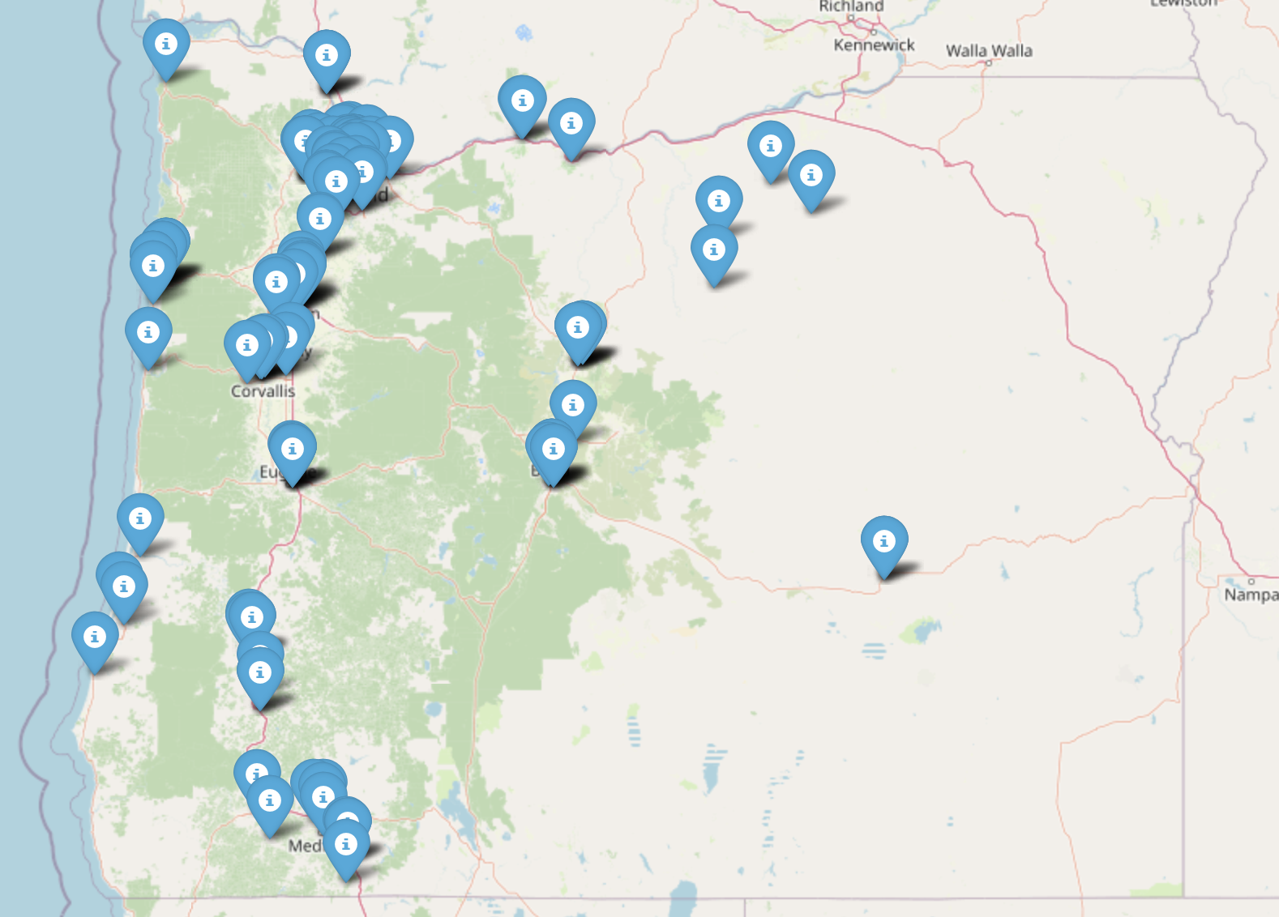
ChargePoint Network

